Slide 1
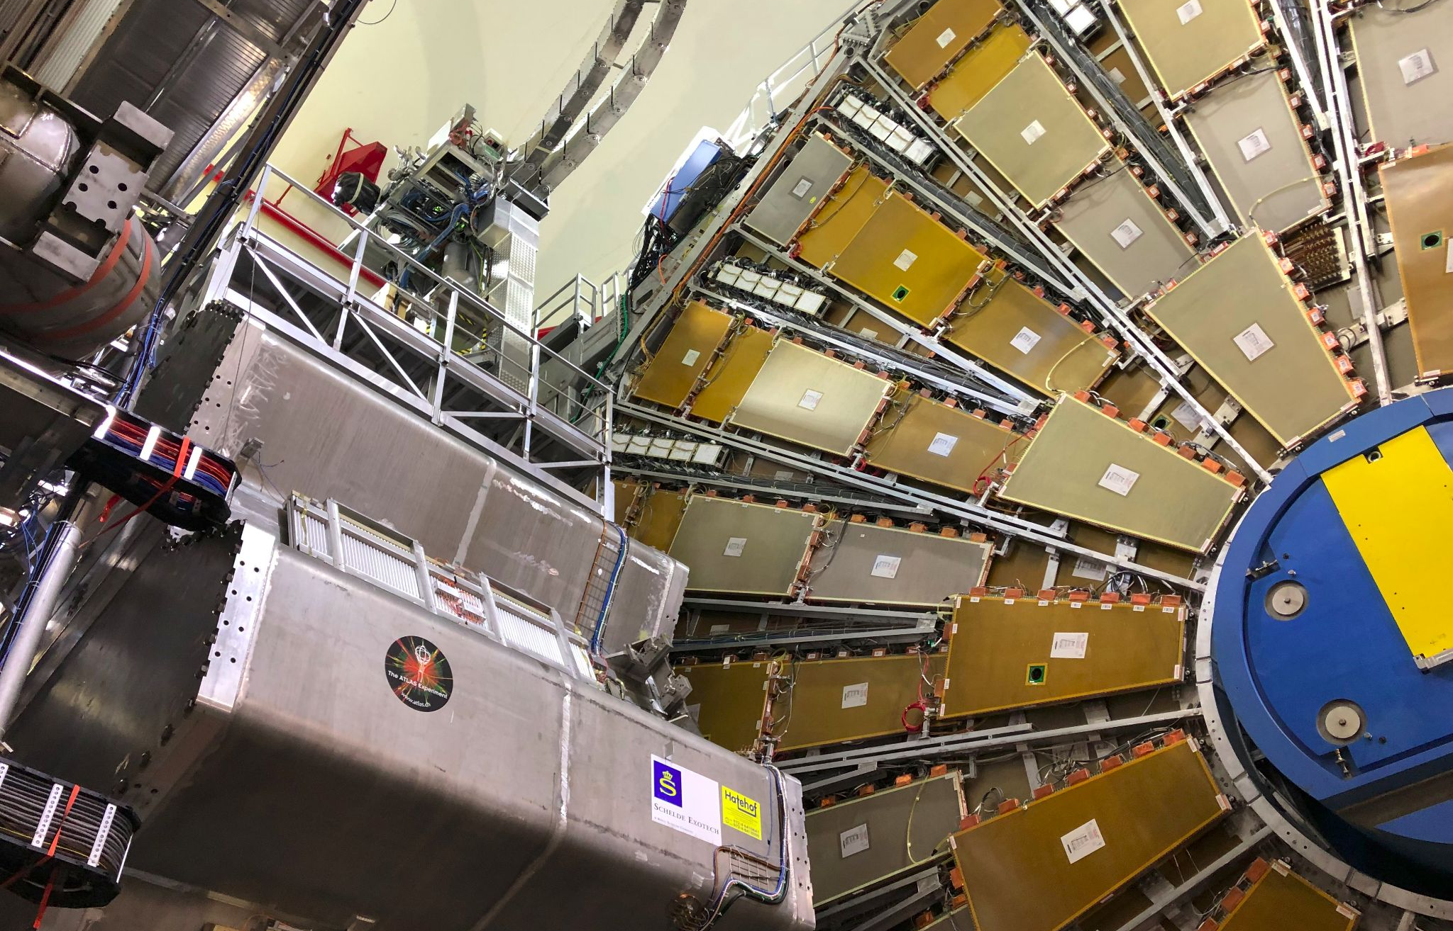

Maintenance Weekly
TileCal Op Meeting, 23 September 2021
Irakli Minashvili, Chris Thomas, Dawit Belayneh, Katie Hughes

Slide 2

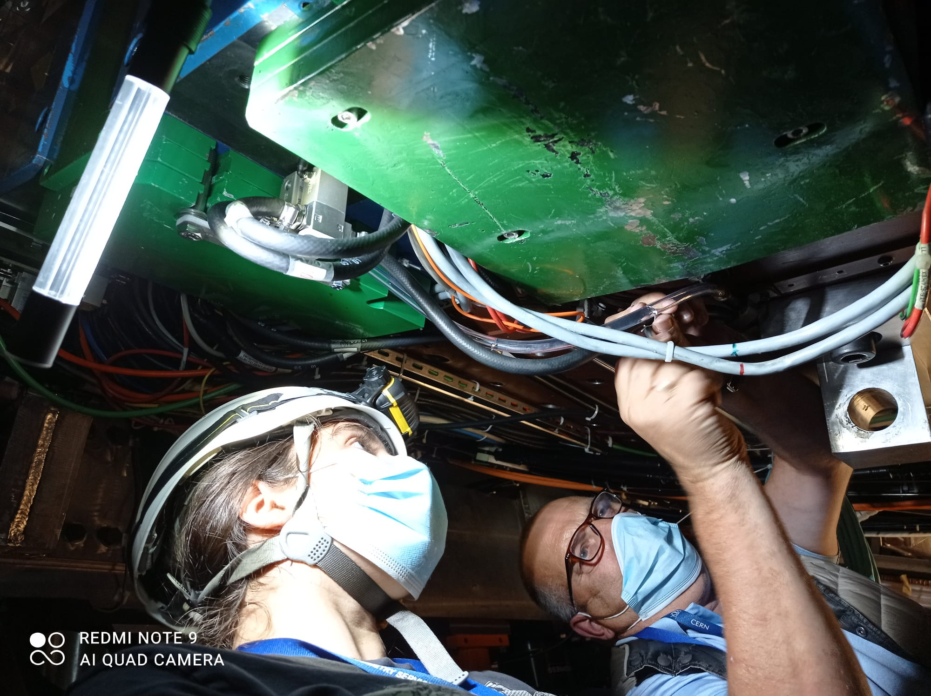
Valve Installation
Connected hoses on all (except 5) modules on EBC!
New method used did not require opening drawers to connect, making the process much quicker
Modules EBC44-48 were opened up to connect before we discovered this method
We will begin mounting+connecting valves on EBA in November

Slide 3
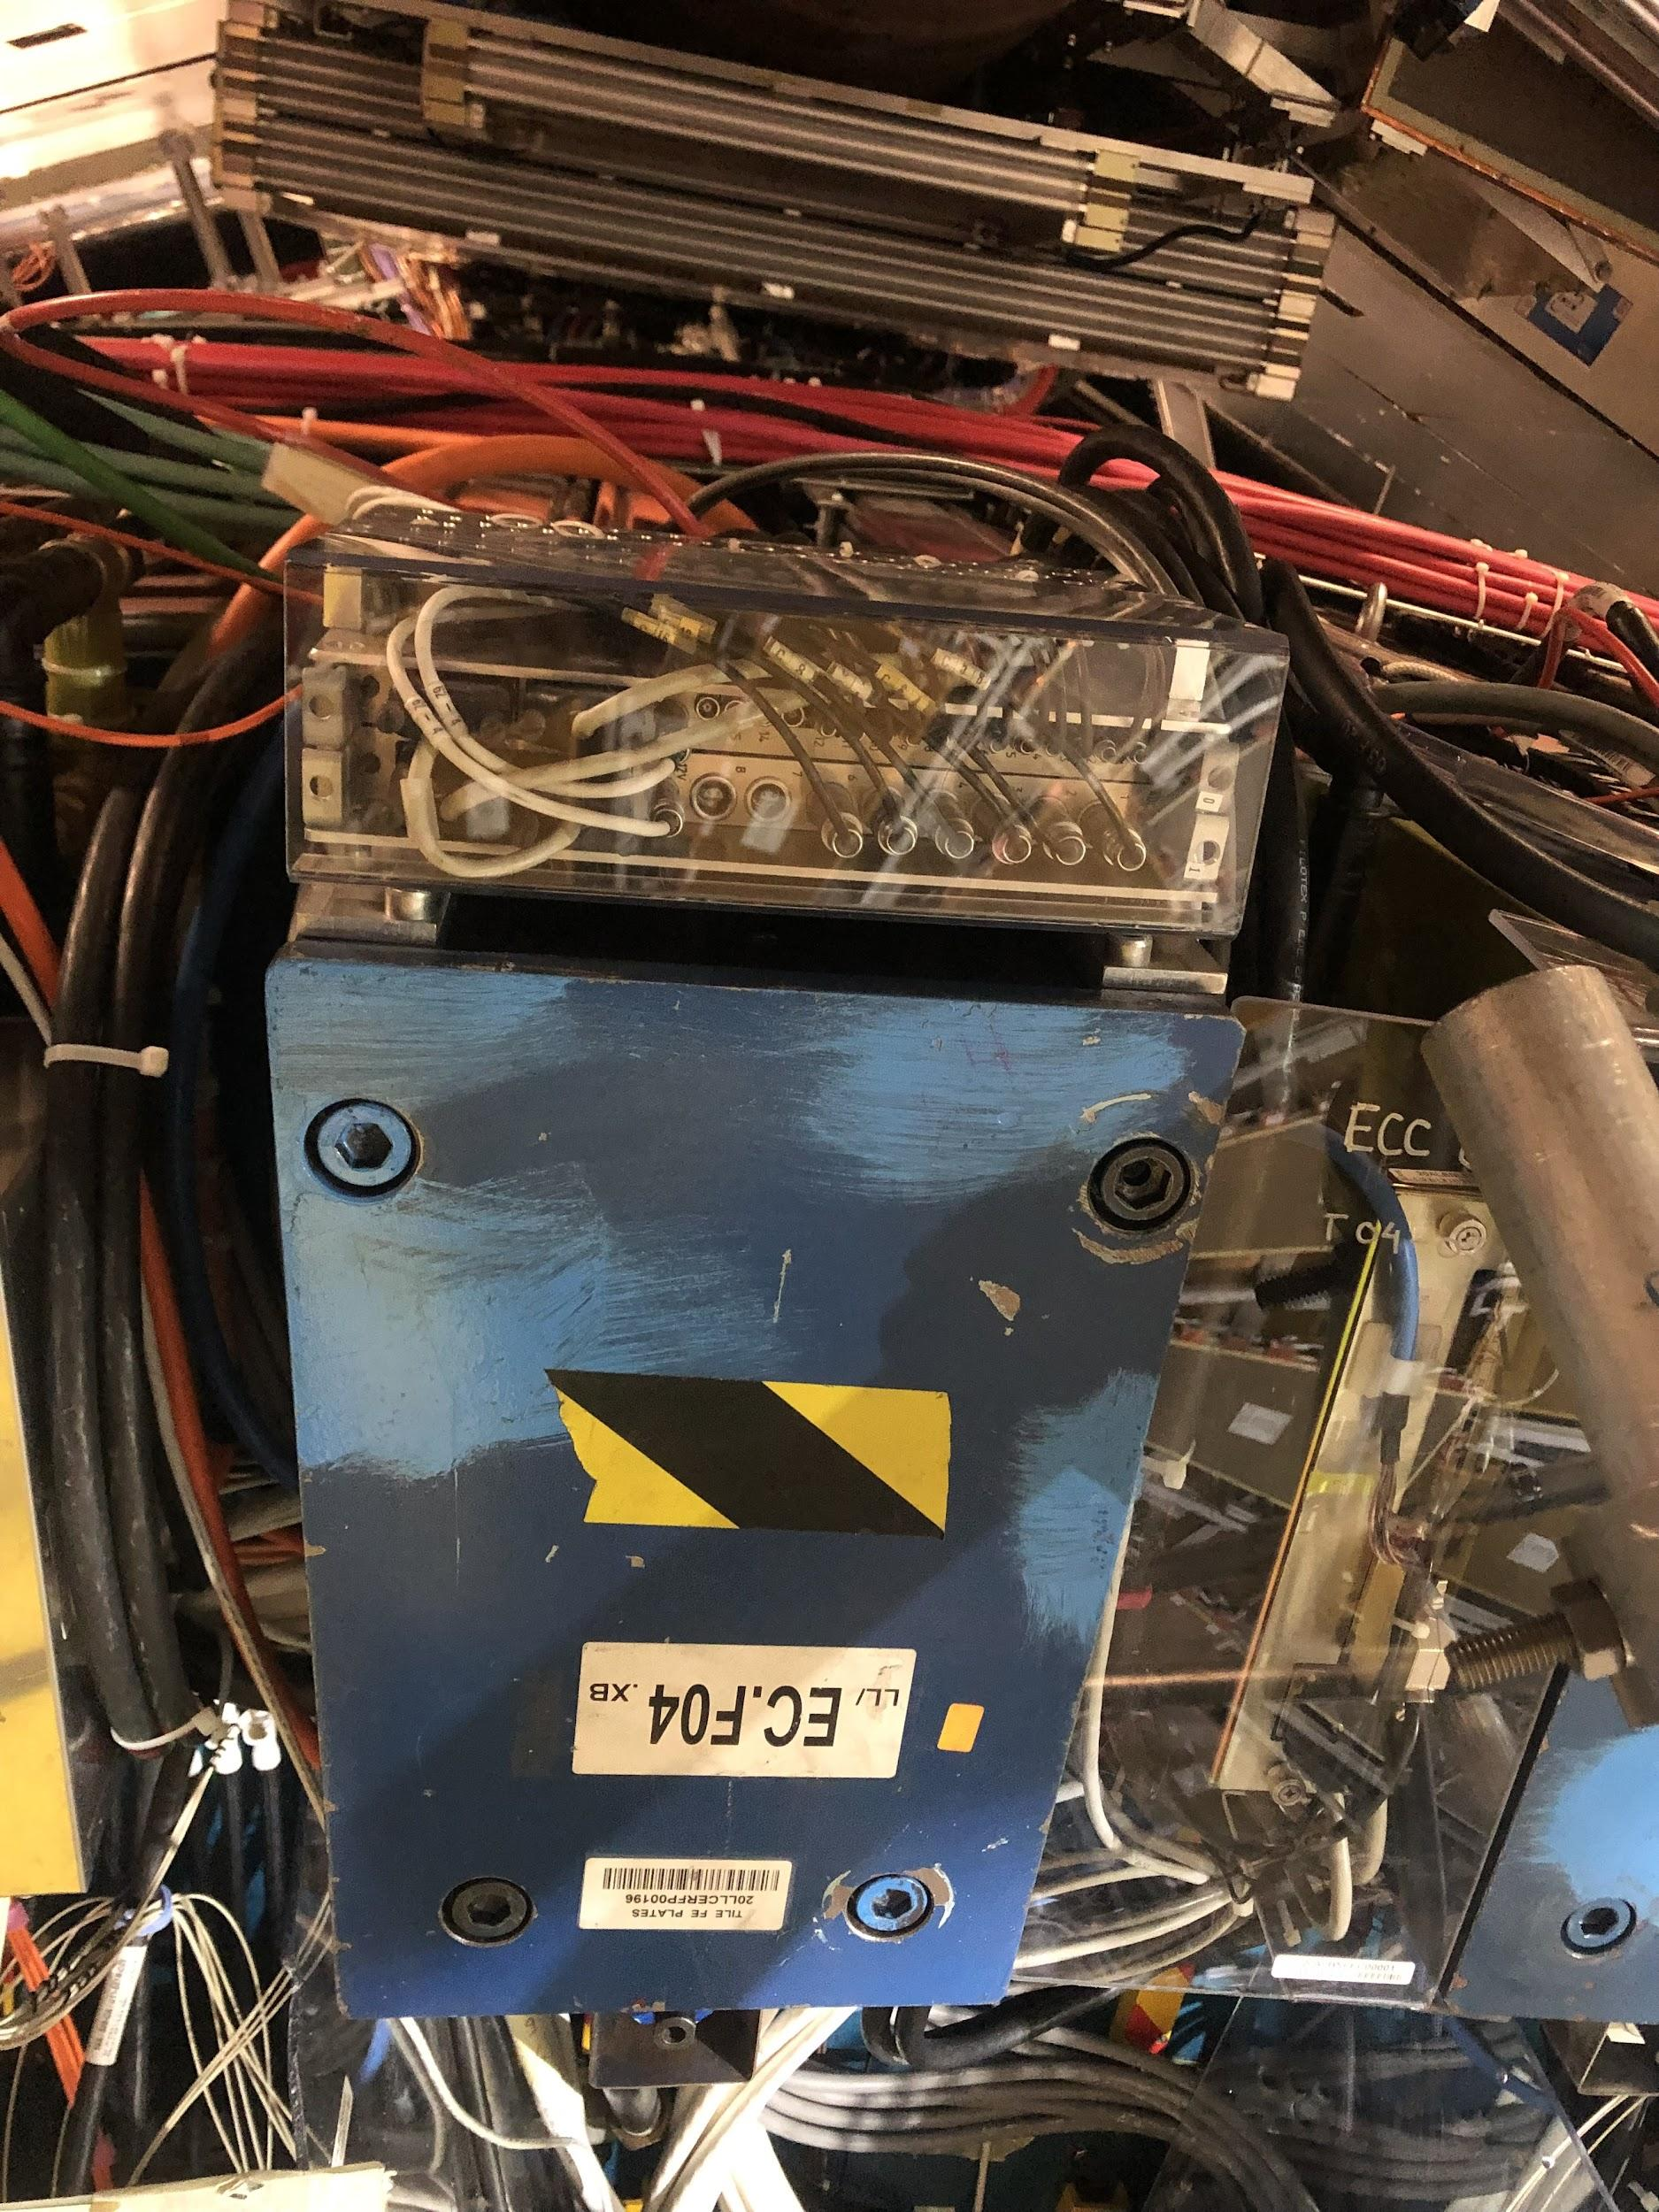
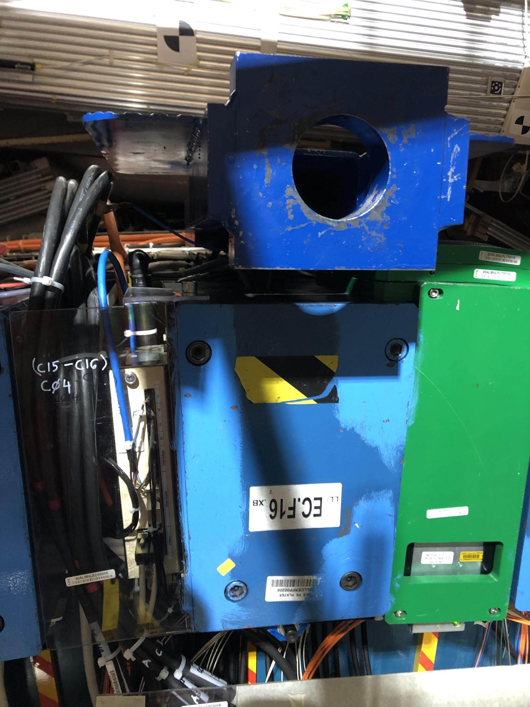
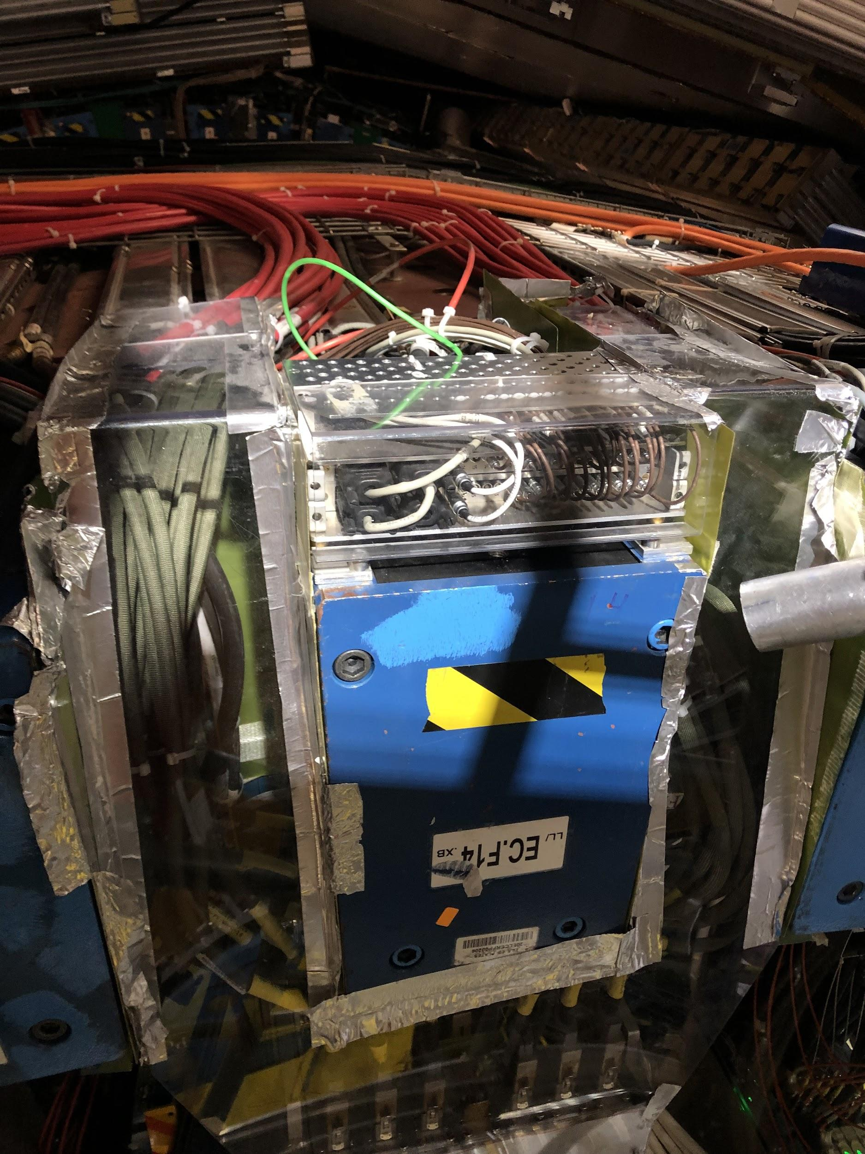
Unconnected Valves (1)
We know how to mount on the side of this, just didn’t have valves with us
No space on top due to wires, can’t access the sides either
Beam blocks valves from fitting underneath

Slide 4
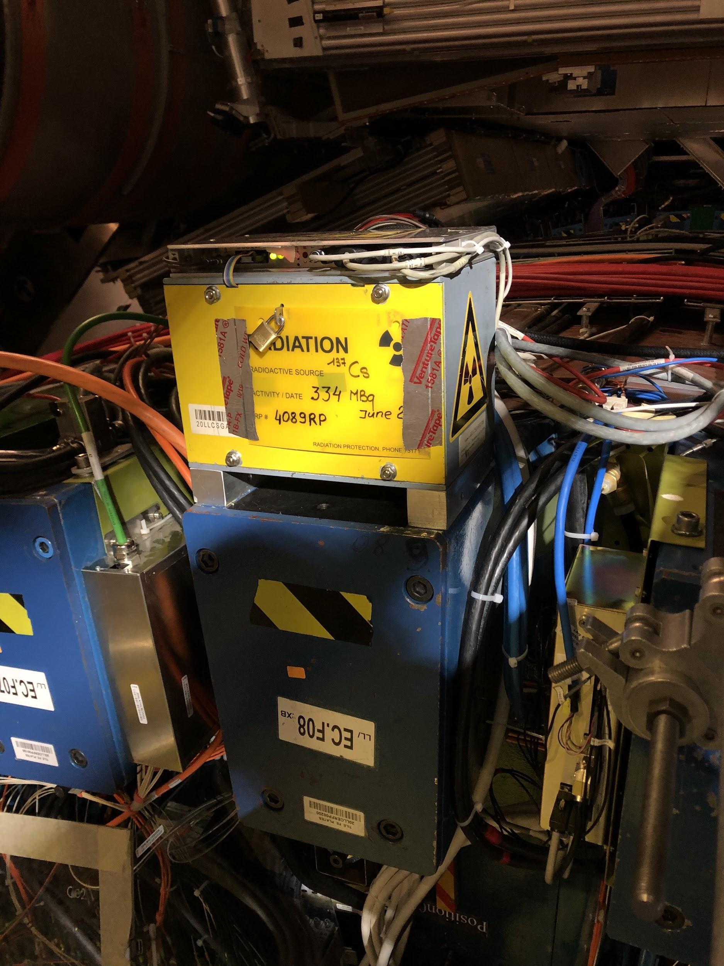
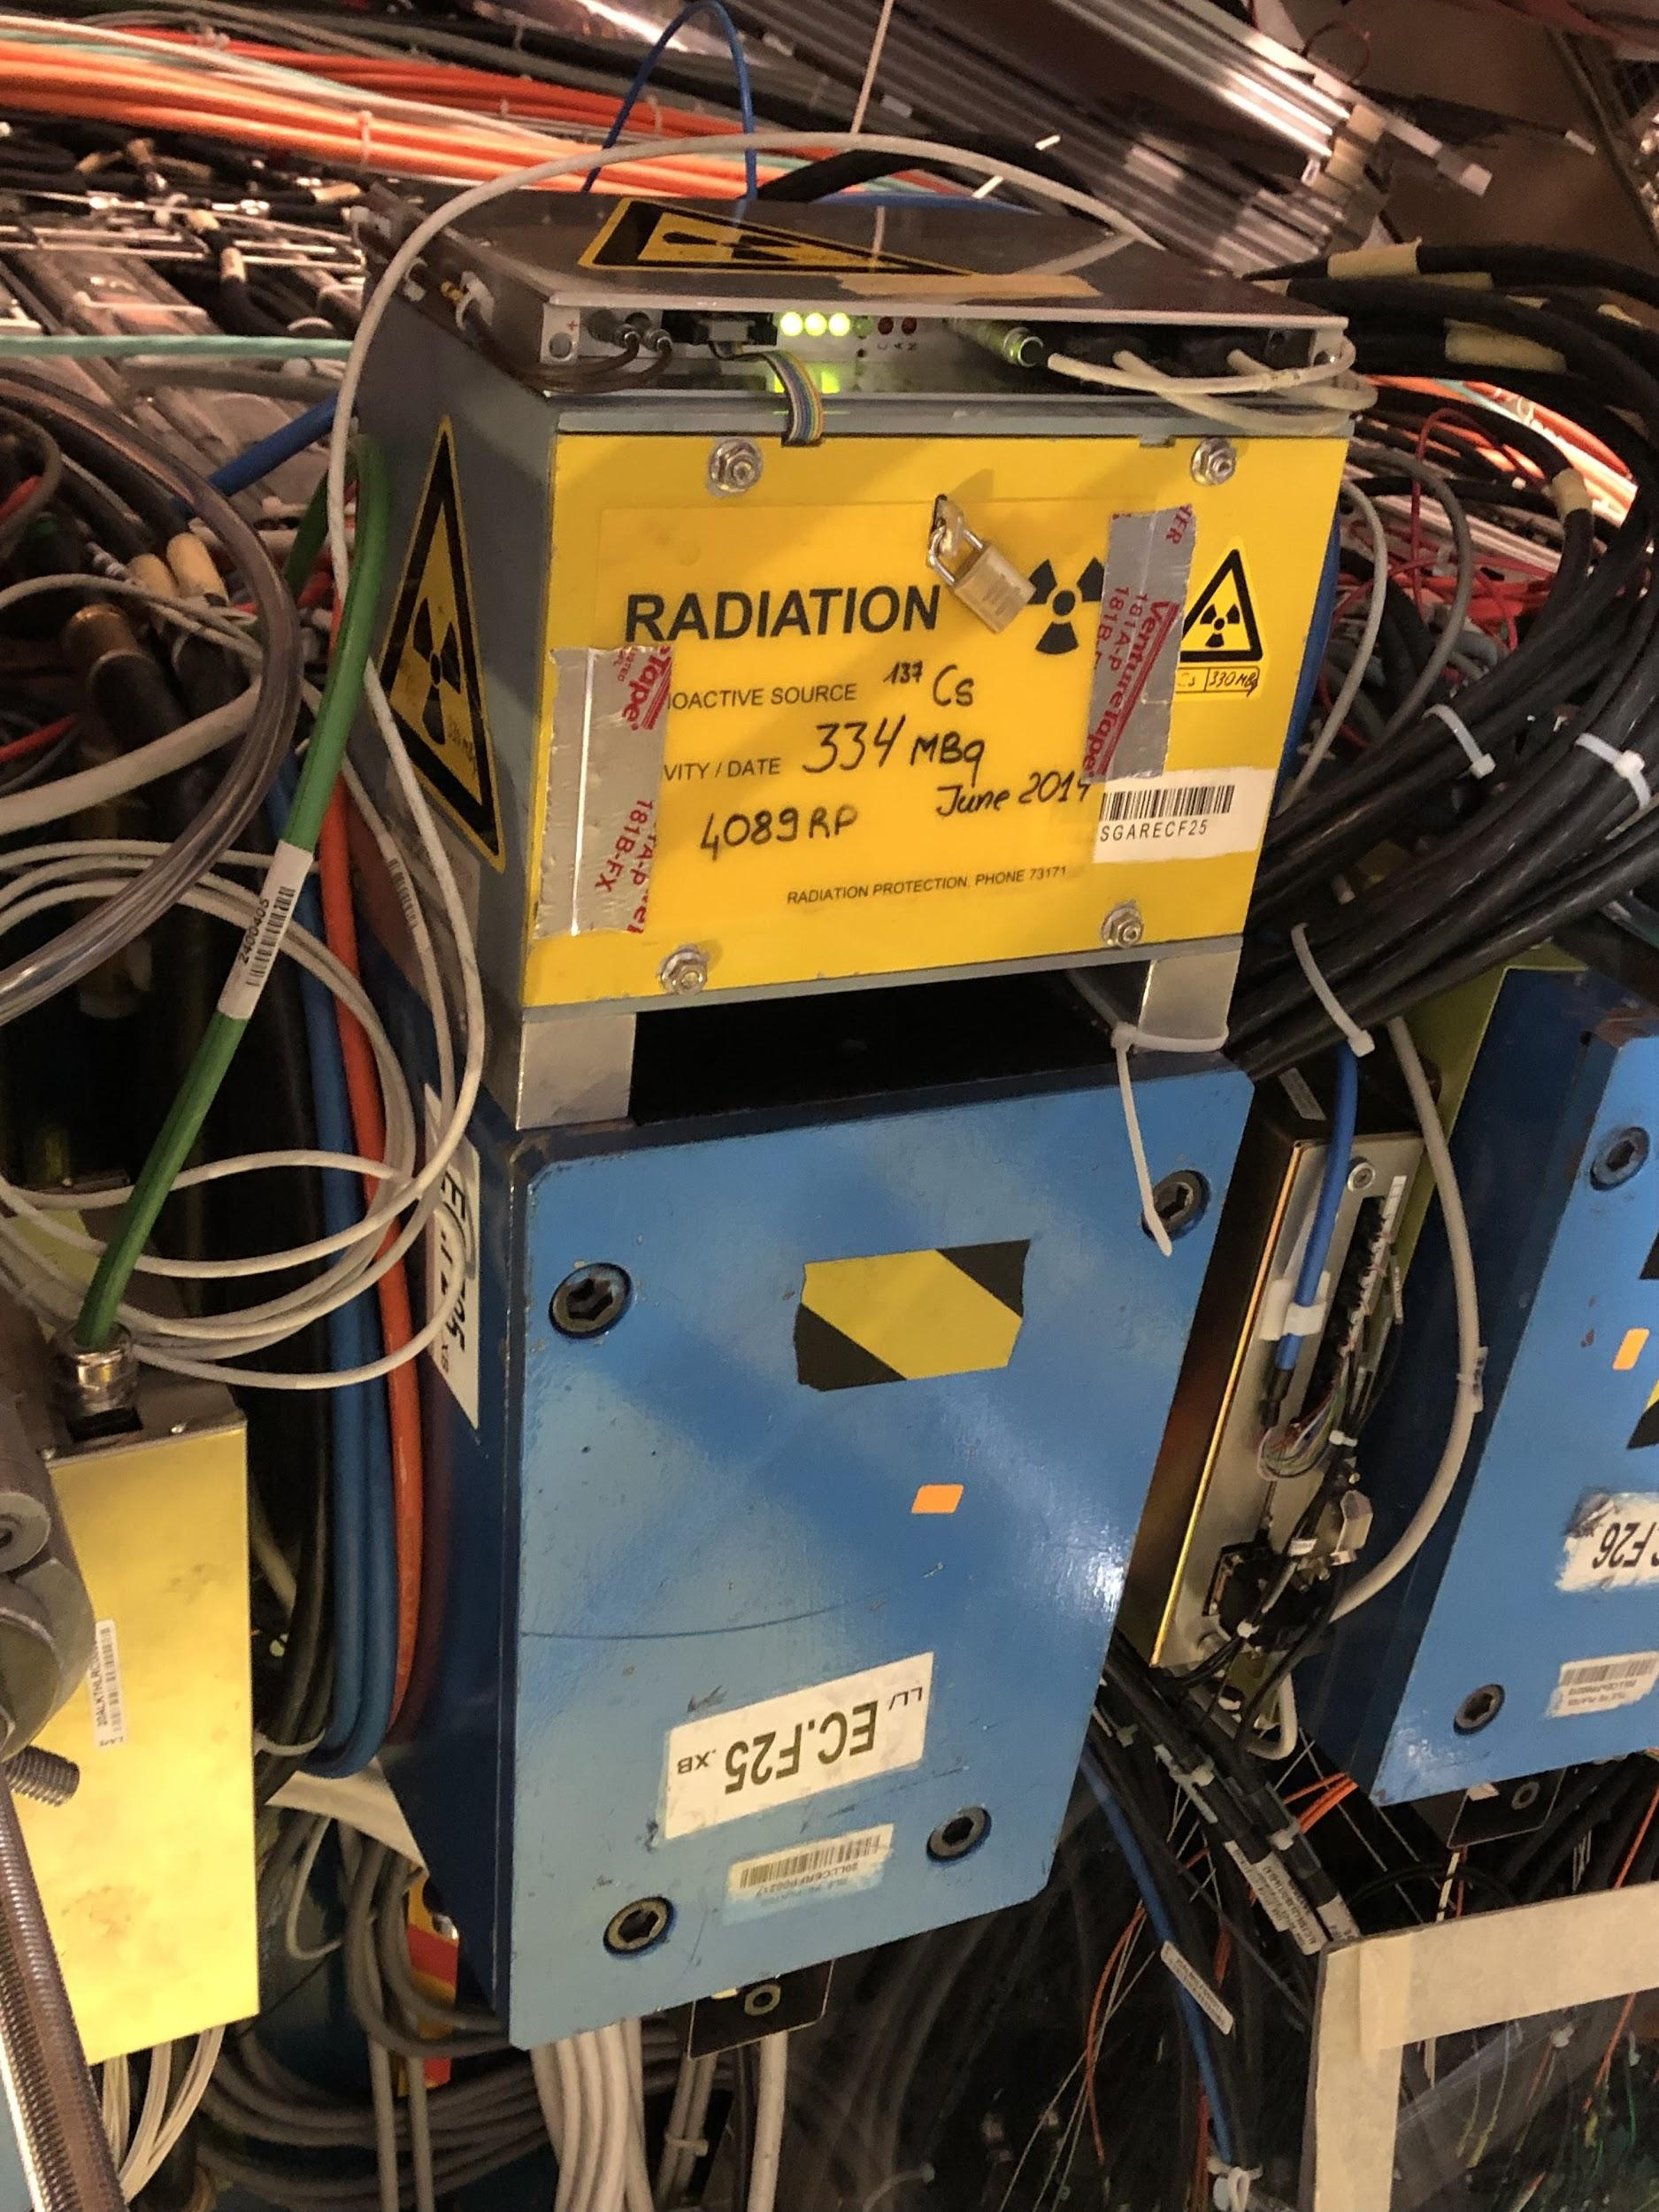
Unconnected Valves (2)
Mounting around these boxes is very tricky, almost no bolt holes are available and the wires are very concentrated behind the box

